Slide 1

PEISS
Power-Efficient Infrared Security System
Carlos Granja Angulo - Photonics Science Engineering
Matthew Berasa - Computer Engineering
Andrew Forde - Electrical Engineering
Andrew Topliffe - Electrical Engineering
Group 12 Midterm Demo Spring 2025
Notes:
Carlos

Slide 2
Overall function of the project
Our project is a power-efficient infrared security system that combines photonic technology with traditional security systems to create something more energy efficient and affordable. We're solving the big problems with regular security systems - they use too much power and cost way too much, especially when you want advanced features that need lots of computing power.
We're designing a system that's not just energy efficient but also cost-effective by using photonics. It's perfect for people who want privacy in their offices, classrooms, bedrooms, or other indoor spaces.
The system is simple to use - you control everything through a mobile app where you can arm or disarm it. When someone trips the system, it sets off an alarm at the location, takes pictures of the intruders, and sends you notifications right away. We've also included backup battery power so it keeps working even if the electricity goes out.
Notes:
Carlos

Slide 3
Engineering Requirements and Specifications
Feature | Requirement
Detection range | 0.5-1 meter
Object detection accuracy | Accuracy of at least 80%
App Latency | Less than 3 seconds
Power consumption | Less than 2W
Wireless communication range | More than 5 meters indoors
Response Time to Object | Less than 20 seconds
Cloud storage for events and image capture | More than 3 days
Component | Parameter | Specification
LED | Field of View | Minimum 40°
 | Wavelength range | 780 - 1000 nm
Photodiode | Field of View | Minimum 40°
 | Wavelength range | 780- 1000 nm
Lens | Focal Length | Less than 7 mm
Filter | Center wavelength | 780 - 1000 nm
Notes:
Andrew T

Slide 4
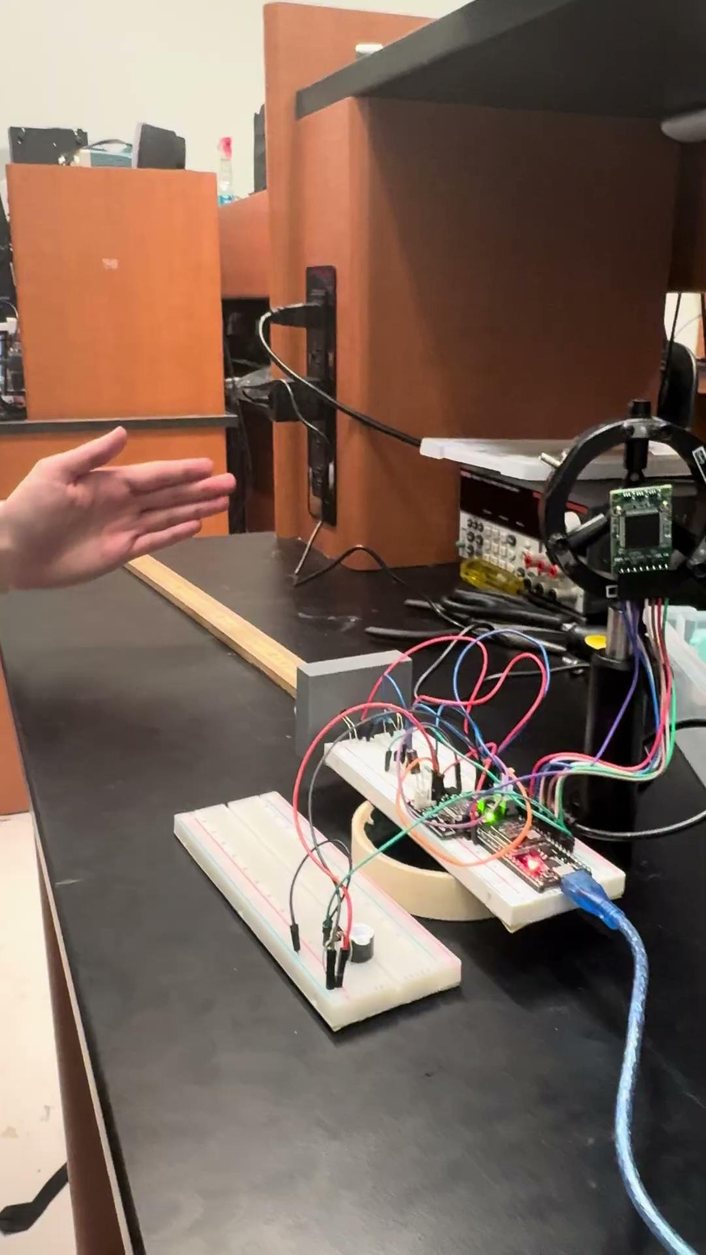
Distance of Sensor/Response Time
Test # | Distance | Response Time
1 | 3 cm | 1 sec
2 | 5 cm | 1.88 sec
3 | 7 cm | 2 sec
4 | 10 cm | 2 sec
5 | 12 cm | 7 sec
6 | 15 cm | 10 sec
7 | 20 cm | 13.71 sec
8 | 25 cm | 14 sec
9 | 30 cm | 16 sec
10 | 35 cm | No response
Testing the time it took for Blue LED Detection to turn on with varying distance.
Notes:
Carlos

Slide 5
System Detection Accuracy
The system was operated continuously for a predefined duration in an object-free environment to quantify the rate of false alarms.
Time | False Alarms
10 minutes | 0
30 minutes | 0
1 hour | 0
Notes:
Matthew

Slide 6
Power Requirements for Hardware
All hardware components in parallel of each other
Absolute max current ~950mA assuming max loads
Hardware | Model | Voltage | Current | Quantity | Total Power
MCU | ESP32 | 3.3V | ≤ 600mA | 1 | 1.98W
Camera | OV2640 | 5V | 70mA active | 1 | 350mW active
Alarm | CMT-8540S-SMT-TR | 5V | 150mA | 1 | 750mW
LED | TSHG6400 | 5V | ~90mA | 1 | 450mW
Relay Coil | J104B2C5VDC.20S | 5V | 40mA | 1 | 200mW
Total |  | 5V | ~950mA |  | 3.73W
Notes:
Andrew T

Slide 7
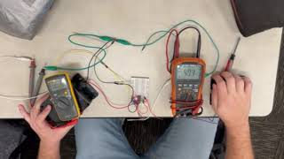
Switching System Design
The system uses a 5V DPDT relay
The main line powers the relay coil
Whenever the PSU is plugged into an outlet, the main will automatically power the system and relay coil.
If power is lost, the relay will automatically switch to backup in < 1 sec
Notes:
Andrew T

Slide 8
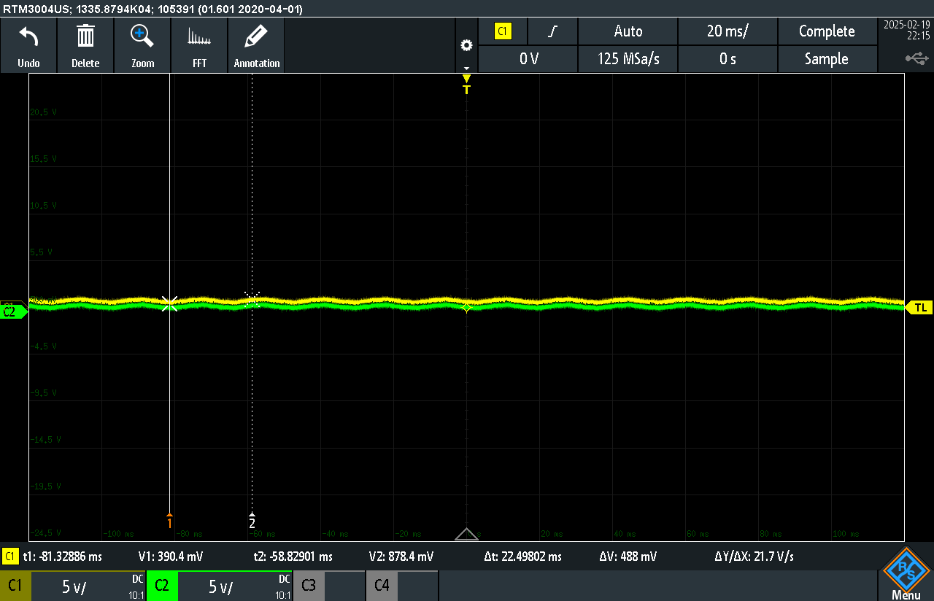
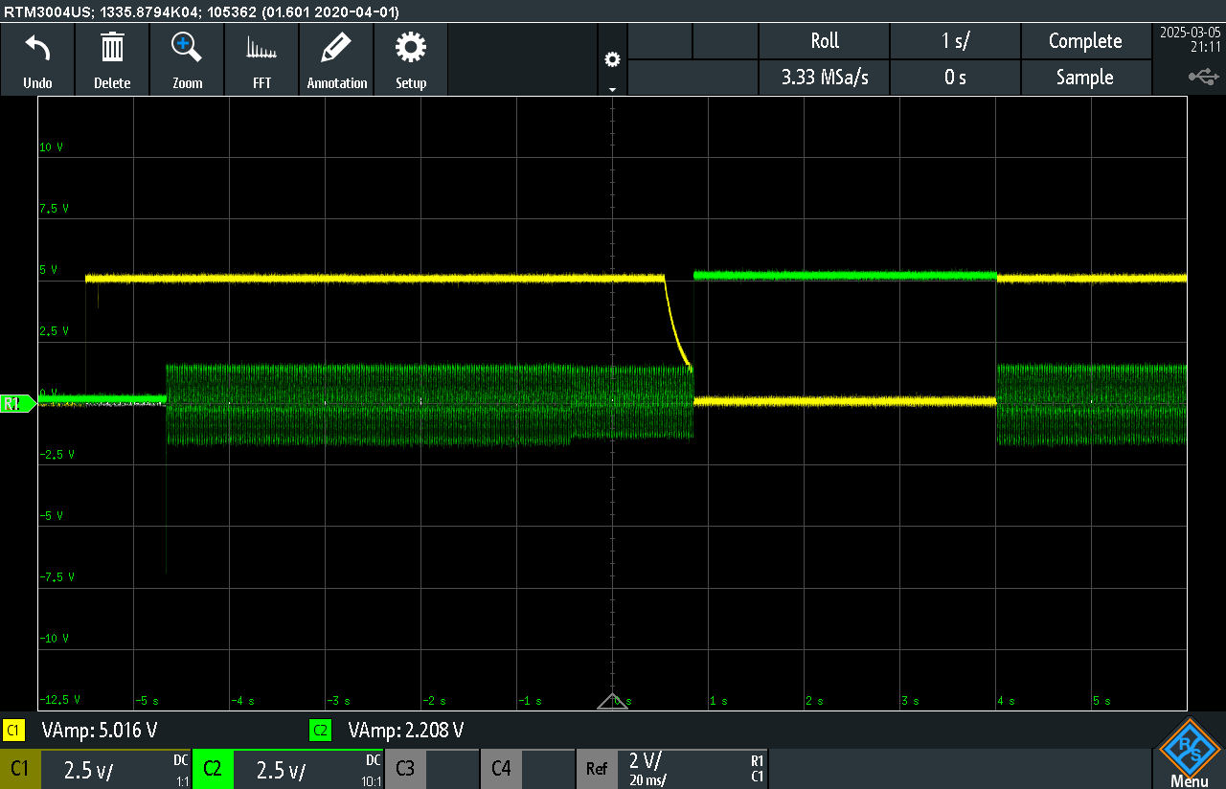
Switching System Testing
Yellow: Main Power Green: Backup Power
Switching system efficiently switches in < 1 sec
Noise detected in the backup line when shut off, roughly 100mV
Main line has a trickle discharge that needs further examination
5V Output
0V Output
Notes:
Andrew T

Slide 9
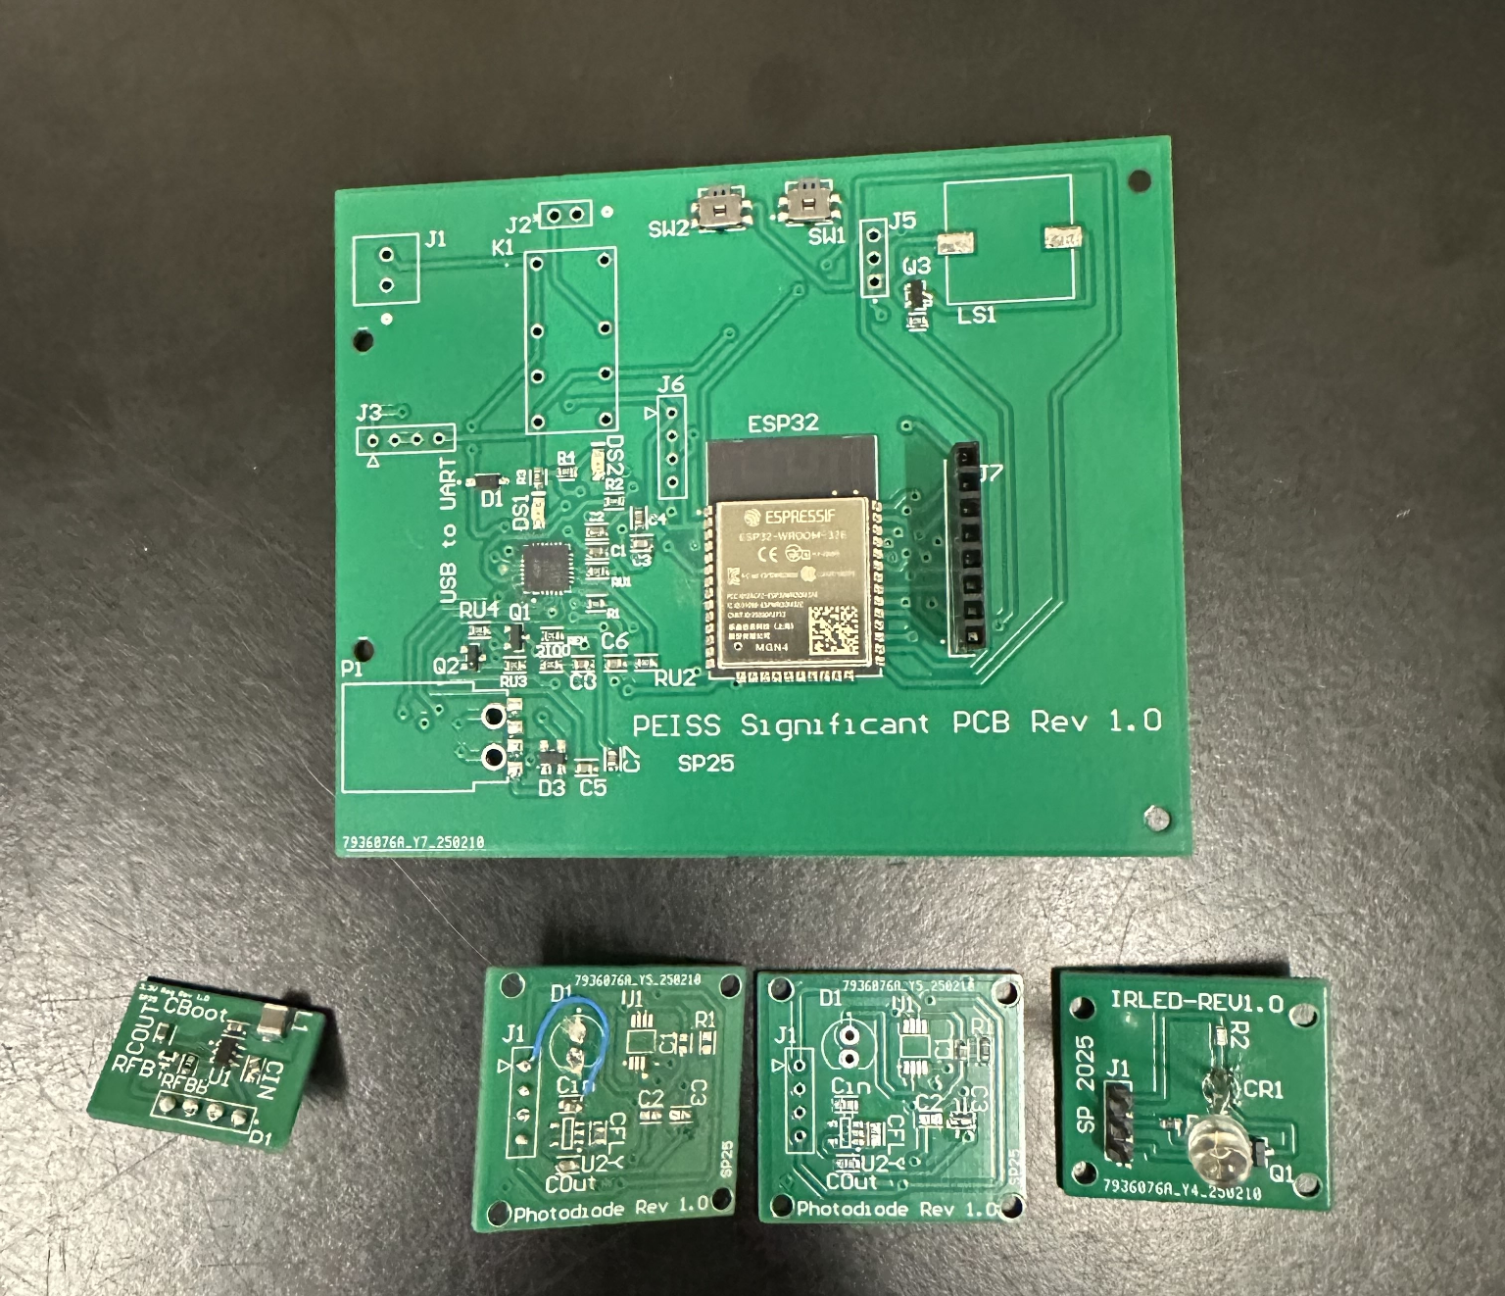
PCB Layout
All 4 boards are fabricated
Working on testing of each board
Issue with switching regulator voltage divider
Photodiode board needs to be reworked to eliminate the inverting charge pump, as it is no longer needed to power our transimpedance op-amp.
We are weighing redesigning our main board to optimize the performance of the ESP32 and other components.
Main power turning on backup power LED when backup power is shut off for status LED.
Main Board
Regulator
IR LED
Photodiode
Photodiode Revision
Notes:
Andrew Forde

Slide 10
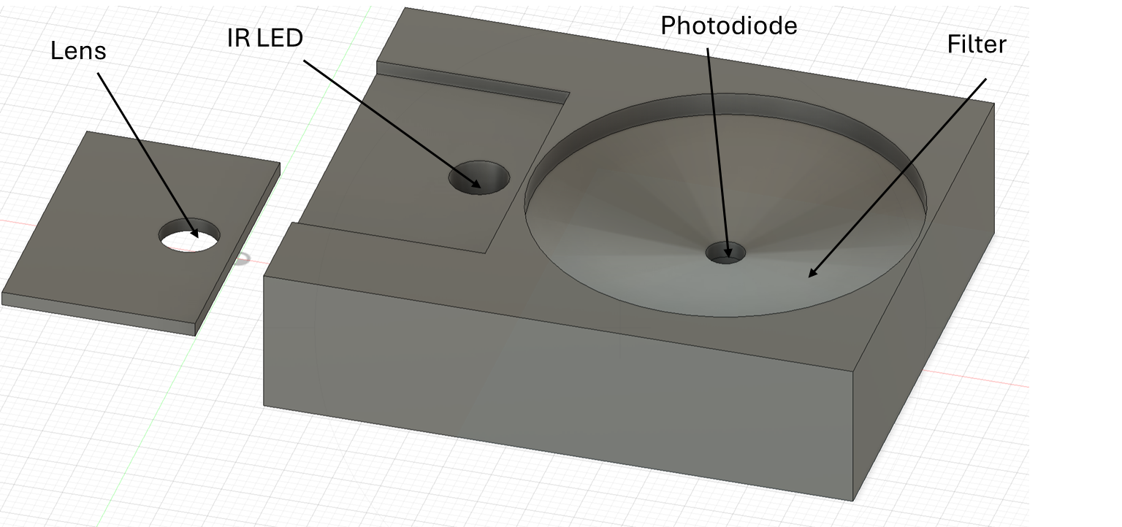
Optical Housing
The optical housing is 3D printed and ensures careful alignment of components.
Distance of 5cm between IR LED and photodiode and ensures 6mm distance for lens and filter.
Reduces ambient light interference and misalignment.
Notes:
Carlos

Slide 11
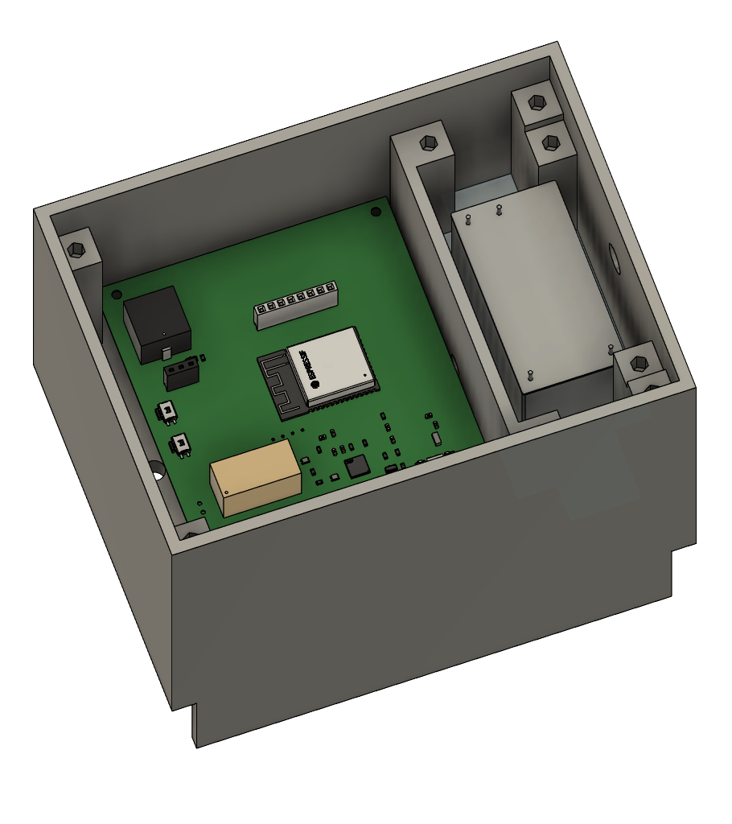
Housing Design
Power Converter
Main PCB
Housing is designed on fusion and
is 3-D printed
The top part will house the main
PCB board and power converter
The bottom will hold the batteries for
ease of access
The lid will hold the LED, Photodiode,
and the camera
Notes:
Andrew T

Slide 12
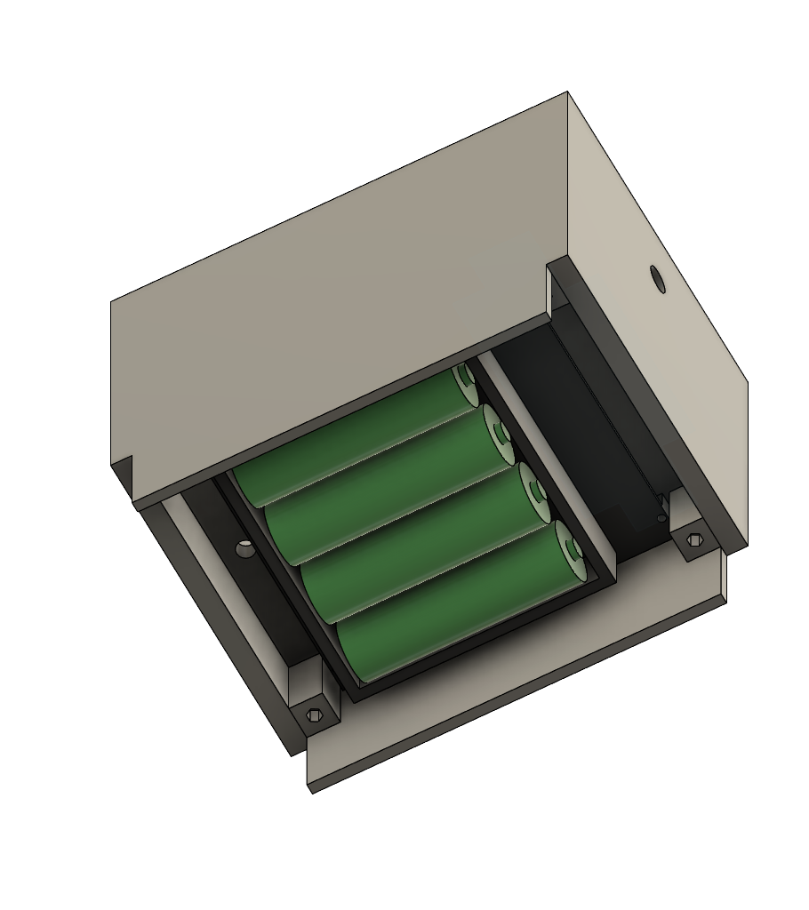
Housing Design: Under Side
Housing going under further designs
Top lid needs to be finished and
hold our LED, photodiode, and camera
Screw holes, wire holes, and hole alignments
need to be further altered
Battery holder
Notes:
Andrew T

Slide 13
Hardware Challenges
Ongoing problems:
LED was not getting enough power, resistor value was reduced and it mas modulated.
Not enough signal getting to the photodiode.
Light interference, required us to use optical filter to reduce false alarms.
Increasing detection distance, increases response time for sensor.
Reworking photodiode board to correctly setup filtering op-amp, as we were previously over supplying voltage.
Switching regulator voltage divider outputting a lower voltage than needed.
Main power turning on backup power status LED when backup power is shut off.
Currently optimizing the Housing for system.
Programming ESP32 on Main PCB using the CP2102 chip.
Notes:
Andrew Forde

Slide 14
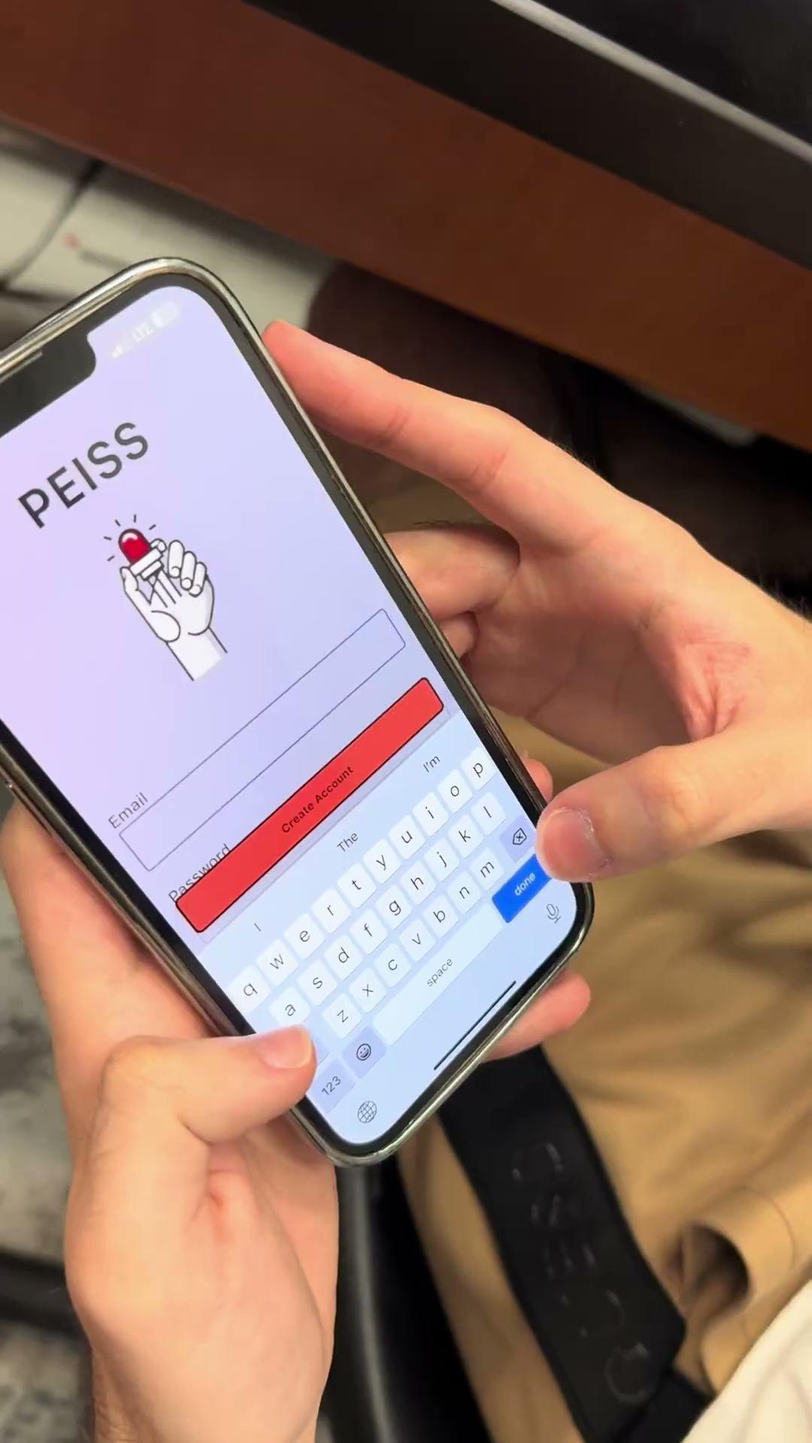
App Basic Functionality
Basic Functionalities:
Login
Register
Connection
Notes:
Matthew

Slide 15
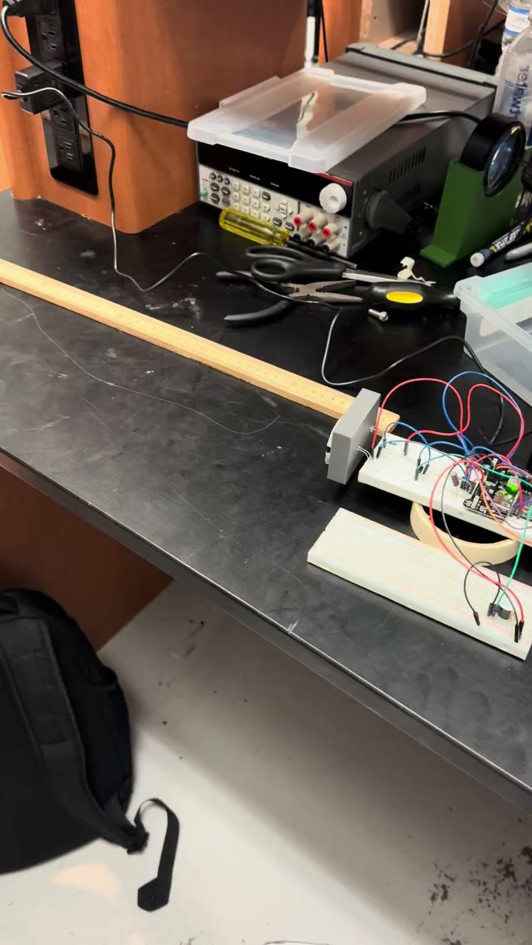
System with App Integration Testing
Test # | App Receiving Detection Log Latency | App Sounding Off Alarm Latency
1 | 1.76 sec | 1.58 sec
2 | 1.88 sec | 2.10 sec
3 | 1.85 sec | 1.95 sec
Testing latency from initial detection alongside latency for alarm response
Notes:
Matthew

Slide 16
Software Challenges
App
Solved:
Flutter Inexperience
Loading of Images in App
Setting up Verification Code
Ongoing:
Implementing Notifications with Firebase
Optimizing User Interface
Embedded Programming
Solved:
HTTP Calls with ESP32
Memory Fragmentation
Establishing WiFi Connection via Access Point
Ongoing:
Optimize Signal Processing
Notes:
Matthew

Slide 17
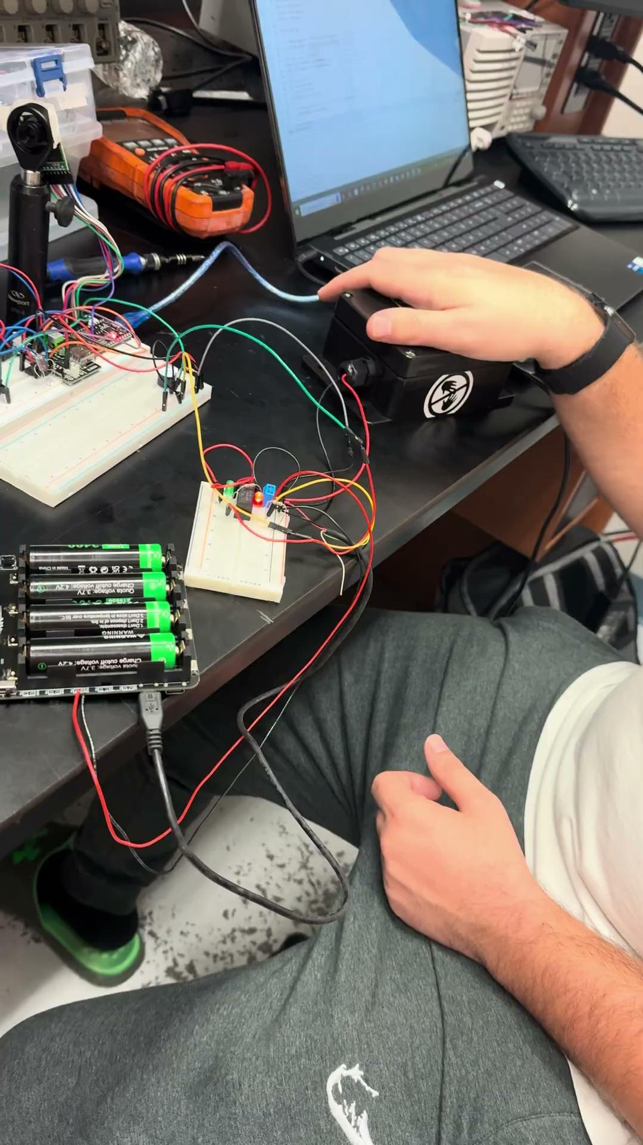
Full System Integration Demo
Demo of full system (Optical, Camera, Alarm, MCU) powered by the Power Supply Unit with app integration.
Notes:
Andrew F

Slide 18
Next Steps
Finish housing design and 3D print
Further PCB Testing and revisions
Final system integration
Final system testing
App final details
Optimizing embedded programming
Notes:
Carlos

